Slide 1
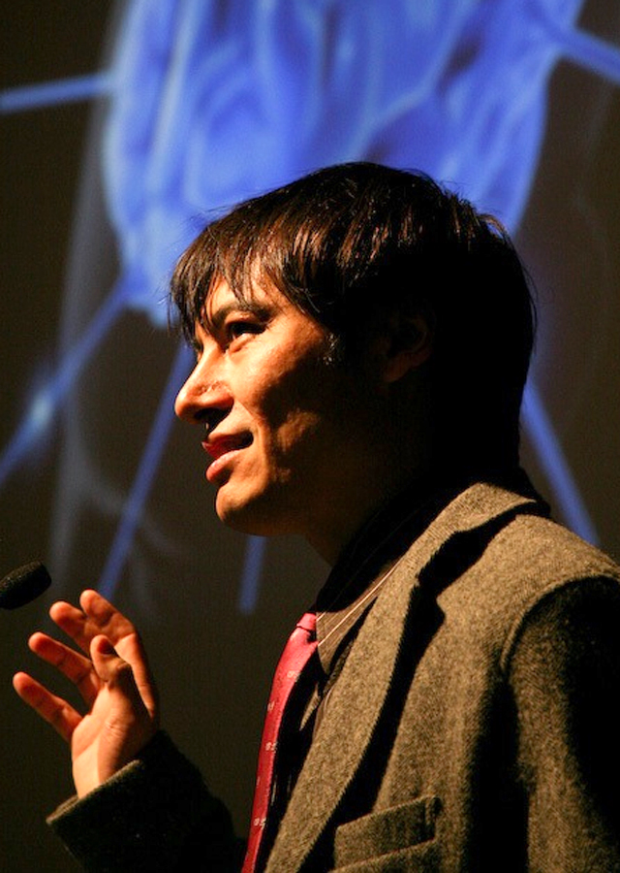
Adrian David Cheok
City University London College Building, Room A304J St John Street EC1V 4PB London, UK

Slide 2
Biography
Adrian David Cheok is a chair Professor of Pervasive Computing at City University London.
He is Founder and Director of the Mixed Reality Lab, Singapore. He was formerly Full Professor at Keio University, Graduate School of Media Design and Associate Professor in the National University of Singapore. He has previously worked in real-time systems, soft computing, and embedded computing in Mitsubishi Electric Research Labs, Japan.
He has been working on research covering mixed reality, human-computer interfaces, wearable computers and ubiquitous computing, fuzzy systems, embedded systems and power electronics.
He has successfully obtained approximately $20 million dollars in funding for externally funded projects in the area of wearable computers and mixed reality from Media Development Authority, Nike, National Oilwell Varco, Defense Science Technology Agency, Ministry of Defense, Ministry of Communications and Arts, National Arts Council, Singapore Science Center, and Hougang Primary School. The research output has included numerous high quality academic journal papers, research awards, keynote speeches, international exhibitions, numerous government demonstrations including to government President and Prime Ministers, broadcast television worldwide broadcasts on his research (such as CNN/CNBC/ABC/Discovery/National Geographic etc.), and hundreds of international press media articles.

Slide 3
Employment
1996 Lecturer (Part-Time) Flinders University, Australia
1996-1998 Electrical Engineer Mitsubishi Electric, Japan
1998-2004 Assistant Professor National University of Singapore, Singapore
2005 Associate Professor Nanyang Technological University, Singapore
2006-2011 Associate Professor National University of Singapore, Singapore
2008-2011 Professor KEIO University, Japan (Joint Appointment)
2012- Professor KEIO University, Japan

Slide 4
Education
B.Eng. (First Class Honors) Electrical and Electronic Engineering, University of Adelaide, 1993.
Ph.D. Electrical and Electronic Engineering, University of Adelaide, 1998.
Graduate Diploma: Global Leadership and Public Policy for the 21st Century, Harvard University, 2010

Slide 5
PUBLICATIONS
http://scholar.google.co.uk/citations?hl=en&user=mP3TUx4AAAAJ

Slide 6
BOOKS
http://adriancheok.info/books/

Slide 7
PRIZES
http://adriancheok.info/prizes/

Slide 8
Thank you

