Slide 1
An Overview Of Diabetes And Endocrinology.

Slide 2
Maraveyas Anthony
Maraveyas Anthony Department of Academic Oncology Castle Hill Hospital England UK Tel: 01482461318

Slide 3
Research interests
Diabetes
Endocrinology.

Slide 4
Endocrinology
The glands in a person's body release hormones. Endocrinologists treat people who suffer from hormonal imbalances, typically from glands in the endocrine system. The overall goal of treatment is to restore the normal balance of hormones found in a patient's body. Some of the more common conditions treated by endocrinologists include:
Menopause
Diabetes
Metabolic disorders
Lack of growth
Osteoporosis
Thyroid diseases
Cancers of the endocrine glands
Over- or under-production of hormones
Cholesterol disorders
Hypertension
Infertility

Slide 5
Endocrinology
Endocrinology is a branch of biology and medicine dealing with the endocrine system, its diseases, and its specific secretions calledhormones, as well as the integration of developmental events
proliferation, growth, and differentiation (including histogenesis andorganogenesis), and also the psychological or behavioral activities of metabolism, growth and development, tissue function, sleep,digestion, respiration, excretion, mood, stress, lactation, movement, reproduction, and sensory perception as caused by hormones.

Slide 6
Clinical trials
Clinical trials are scientific research studies that involve people. Their overall goal is to improve endocrine health and health care by answering specific questions about how to better prevent, detect, and treat endocrine diseases. Many of today’s most effective prevention and treatment methods were tested and proven in clinical trials and are now accepted as the “standard of care.”

Slide 7
An Introduction to Clinical Trials
A Patient’s Guide to Minority Participation in Clinical Trials If clinical trials are to be useful to the entire U.S. population, people from all backgrounds and races need to participate. Learn more about why it is important for minorities to take part in clinical trials and how to volunteer. The patient’s guide is a companion to The Endocrine Society’s document on Increasing Minority Participation in Clinical Research.
Center for Information and Study on Clinical Research Participation (CISCRP) CISCRP is an organization devoted to improving public participation in clinical trials by improving awareness and communication between trial conductors and participants.

Slide 8
The Value of Endocrine Research Learn how research in cancer, growth hormone deficiency, osteoporosis, and diabetes have made substantial contributions to health and the practice of medicine.
Program for Healthy Volunteers The Clinical Research Volunteer Program provides an opportunity for healthy volunteers from around the world to participate in medical research studies. Healthy volunteers provide researchers with important information for comparison with people who have specific illnesses. Every year, nearly 3,500 healthy volunteers participate in studies at the National Institutes of Health (NIH).
NIH Clinical Alerts and Advisories These clinical alerts expedite the release of findings from NIH-funded clinical trials when their release could significantly affect health.

Slide 9
Diabetes mellitus (DM)
Diabetes mellitus (DM), also known as simply diabetes, is a group of metabolic diseases in which there are high blood sugar levels over a prolonged period.
This high blood sugar produces the symptoms of frequent urination, increased thirst, and increased hunger. Untreated, diabetes can cause many complications.
Acute complications include diabetic ketoacidosis and nonketotic hyperosmolar coma.Serious long-term complications include heart disease, stroke, kidney failure, foot ulcers and damage to the eyes.
Diabetes is due to either the pancreas not producing enough insulin, or the cells of the body not responding properly to the insulin produced.

Slide 10
Three main types of diabetes mellitus:
Type 1 DM results from the body's failure to produce enough insulin. This form was previously referred to as "insulin-dependent diabetes mellitus" (IDDM) or "juvenile diabetes". The cause is unknown.[3]
Type 2 DM begins with insulin resistance, a condition in which cells fail to respond to insulin properly.[3] As the disease progresses a lack of insulin may also develop.[6] This form was previously referred to as "non insulin-dependent diabetes mellitus" (NIDDM) or "adult-onset diabetes". The primary cause is excessive body weight and not enough exercise.[3]
Gestational diabetes, is the third main form and occurs when pregnant women without a previous history of diabetes develop a high blood glucose level.[3]

Slide 11
FACTS ABOUT DIABETES
Diabetes is a long-term condition that causes high blood sugar levels.
In 2013 it was estimated that over 382 million people throughout the world had diabetes (Williams textbook of endocrinology).
Hypoglycemia - low blood glucose - can have a bad effect on the patient. Hyperglycemia - when blood glucose is too high - can also have a bad effect on the patient

Slide 12
Type 1 Diabetes - the body does not produce insulin. Approximately 10% of all diabetes cases are type 1.
Type 2 Diabetes - the body does not produce enough insulin for proper function. Approximately 90% of all cases of diabetes worldwide are of this type.
Gestational Diabetes - this type affects females during pregnancy.
The most common diabetes symptoms include frequent urination, intense thirst and hunger, weight gain, unusual weight loss, fatigue, cuts and bruises that do not heal, male sexual dysfunction, numbness and tingling in hands and feet.

Slide 13
If you have Type 1 and follow a healthy eating plan, do adequate exercise, and take insulin, you can lead a normal life.
Type 2 patients need to eat healthily, be physically active, and test their blood glucose. They may also need to take oral medication, and/or insulin to control blood glucose levels.
As the risk of cardiovascular disease is much higher for a diabetic, it is crucial that blood pressure and cholesterol levels are monitored regularly.
As smoking might have a serious effect on cardiovascular health, diabetics should stop smoking.

Slide 14
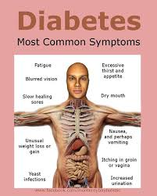
SYMPTOMS OF DIABETES

Slide 15
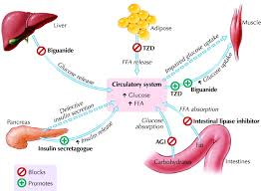

Slide 16
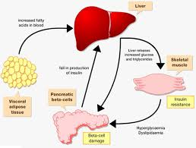

Slide 17
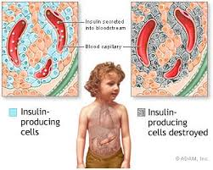

Slide 18
Prediabetes Exams and Tests
Find out what tests are used in diagnosing prediabetes.
How to Stop Prediabetes Progression
Treatments for prediabetes can prevent the onset of type 2 diabetes. Learn more about how to stop insulin resistance in its tracks.

Slide 19
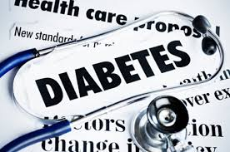
Prediabetes
Prediabetes
Prediabetes, also known as "impaired glucose tolerance" or “impaired fasting glucose,” is a health condition with no symptoms.
What Is Prediabetes
More and more, doctors are recognizing
the importance of diagnosing prediabetes
as treatment of the condition may
prevent more serious health problems.

Slide 20
Insulin Resistance and Diabetes
Insulin resistance or metabolic syndrome describes a combination of health problems that have a common link -- an increased risk of diabetes and early heart disease.
What Is Prediabetes or Borderline Diabetes?
People with prediabetes have glucose levels that are higher than normal but not high enough yet to indicate diabetes. The condition used to be called borderline diabetes.

Slide 21
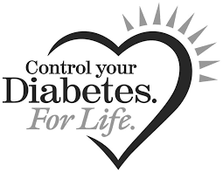
THANK YOU

